Slide 1
“Spectral Richness”: Equal vs. Just Intonation
A Presentation by
Jakob Georg Ruderer
For Musical Signal Processing with
Prof. Johanna Devaney

Slide 2
Just Intonation Versus Equal Intonation
Just temperament is based on the overtone series, depending on the Depending on Fundamental/Tonic one is in
Notes are related to the fundamental by rational numbers, semitones are not equally spaced
Equal Temperament was developed for instruments such as keyboard intruments to be able to play in any key, Equally => compromise
Frequencies of notes are related to their neighboring semitones by a factor of the twelfth square root of 2 (~1.059463094...)

Slide 3
Just Intonation Versus Equal Intonation
Interval Ratios to Fundamental:
Just
Unison: 1
Minor Second: 25/24 (1.0417)
Major Second: 9/8 (1.125)
Minor Third: 6/5 (1.2)
Major Third: 5/4 (1.25)
Fourth: 4/3 (1.33)
Diminished Fifth: 45/32 (1.4063)
Fifth: 3/2 (1.5)
…
Equal:
1
1.05946
1.12246
1.18921
1.25992
1.33483
1.41421
1.49831
…

Slide 4
Material Generated and Temperaments Used for this Project
Based on Equal Temperament, creation of Audio files:
Based on A4 = 440 Hz, the tonic being C
Human Voice or electric piano recordings of three voiced chord progressions: Authentic Cadence, Imperfect Cadence, Plagal Cadence, Deceptive Cadence (Interrupted Cadence) with seventh partial
Each voice recorded seperately
Detuned each voice of each recording to equal and just Intonation by cents
Some extraction audio files of two voices to show intervallic differences
Over 40 files created, focusing on 18 for this project

Slide 5
Hypothesis
Due to the richness of distances to neighboring notes caused by the ratios of just temperament, there is a spectral richness within just tempered music and its harmonies which is richer and contrasts strongly from its counterpart, the Equal Temperament with its equal distances in the chromatic scale.

Slide 6
Personal Listening Experience
Voice Singing Imperfect Cadence in Equal Intonation
Voice Singing Imperfect Cadence in Just Intonation
Piano Playing Imperfect Cadence in Equal Intonation
Voice Singing Imperfect Cadence in Equal Intonation
Piano Playing Authentic Cadence in Equal Intonation
Piano Playing Authentic Cadence in Just Intonation

Slide 7
Personal Listening Experience
Piano Playing Plagal Cadence in Equal Intonation
Piano Playing Plagal Cadence in Just Intonation
Upper Two Voices Equal Intonation
Upper Two Voices Just Intonation
Upper and Lower Two Voice Equal Intonation
Upper and Lower Two Voice Just Intonation
Lower Two Voices Equal Intonation
Lower Two Voices Just Intonation

Slide 8
Personal Listening Experience
Voice Singing Deceptive Cadence
with 7th partial (bB4) in Equal Intonation
Voice Singing Deceptive Cadence
with 7th partial (bB4) in Just Intonation
Piano Playing Deceptive Cadence
with 7th partial (bB4) in Equal Intonation
Piano Playing Deceptive Cadence
with 7th partial (bB4) in Just Intonation

Slide 9
Spectral Analysis
Mel Spectrogram
Spectral Centroid
Spectral Bandwidth
Spectral Contrast
Spectral Flatness

Slide 10
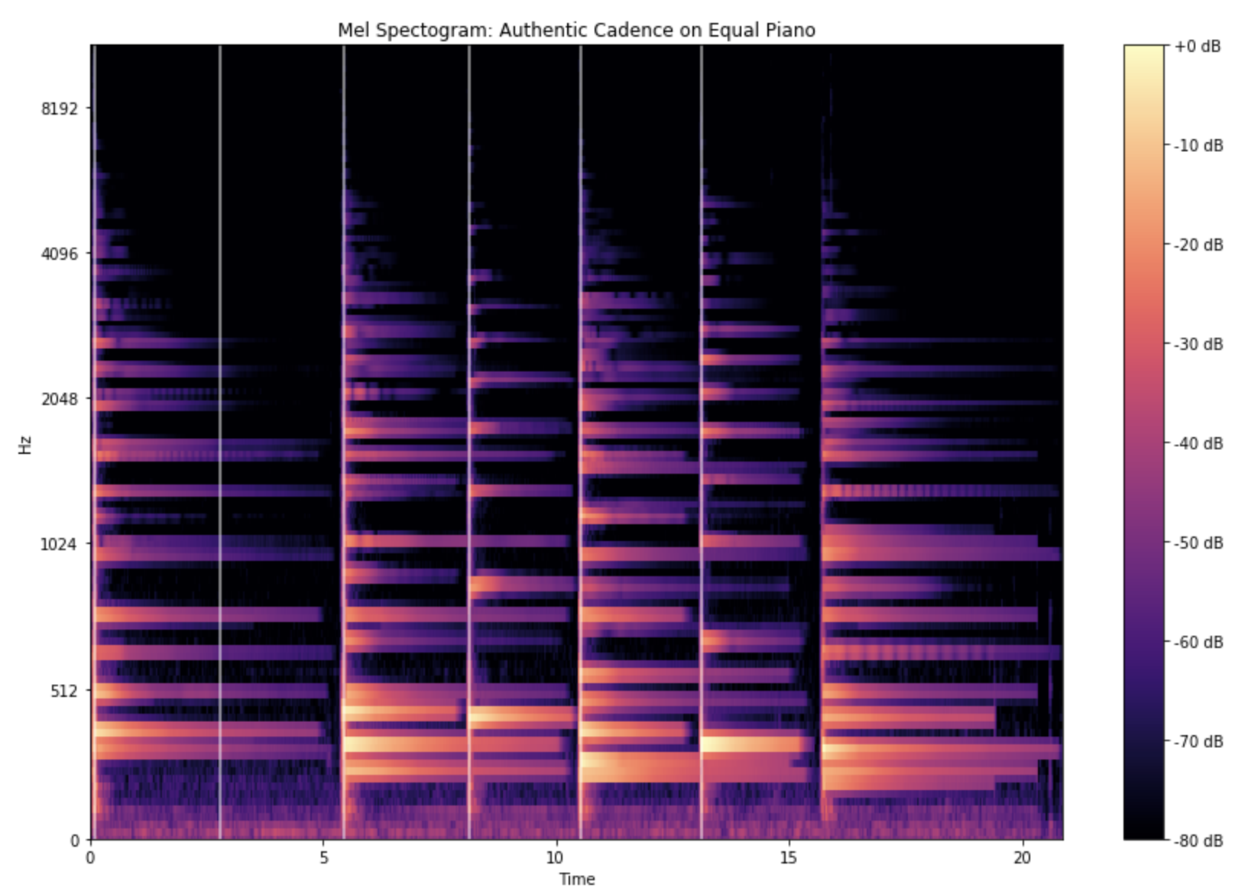
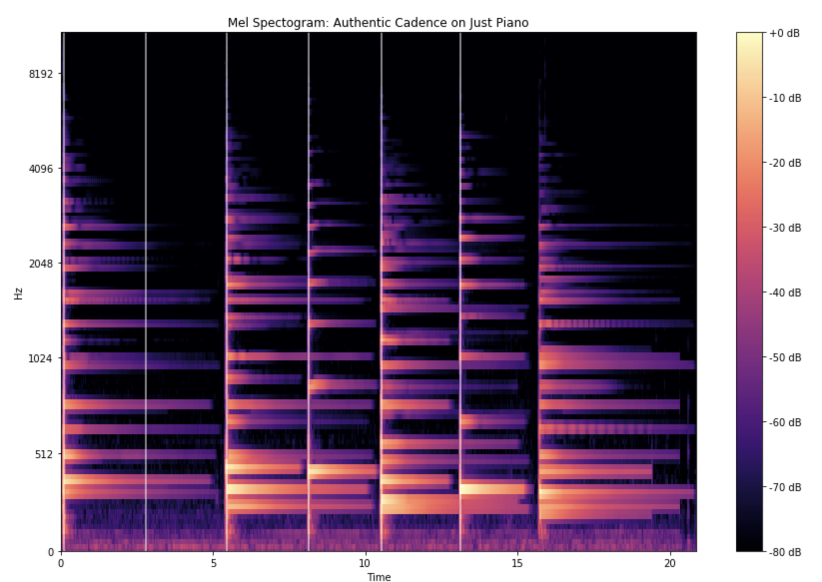
Spectral Analysis

Slide 11
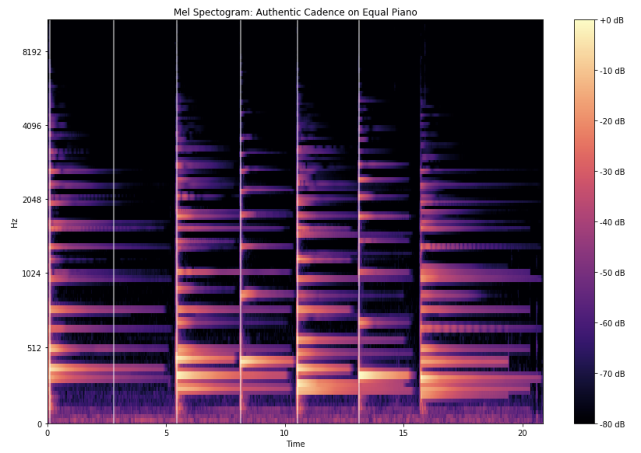

Spectral Analysis

Slide 12
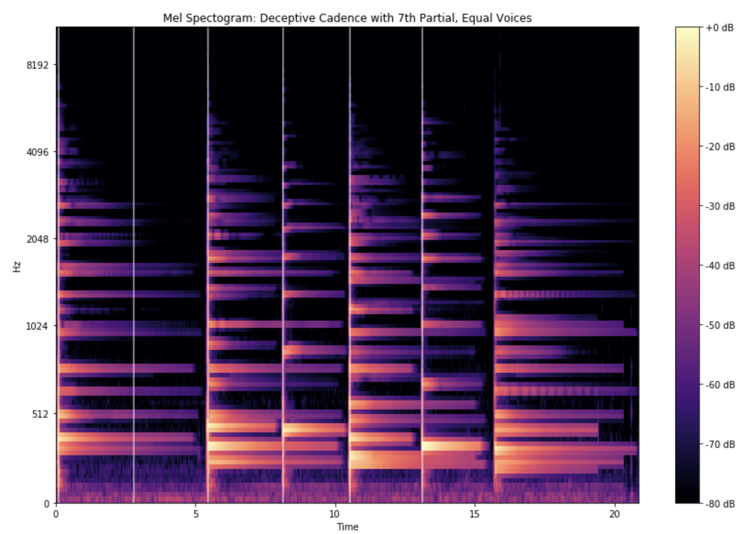

Spectral Analysis

Slide 13
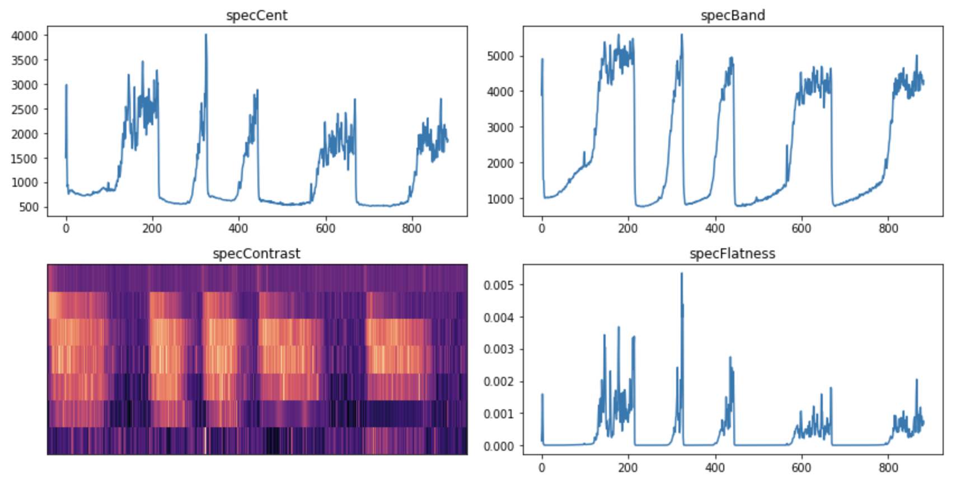
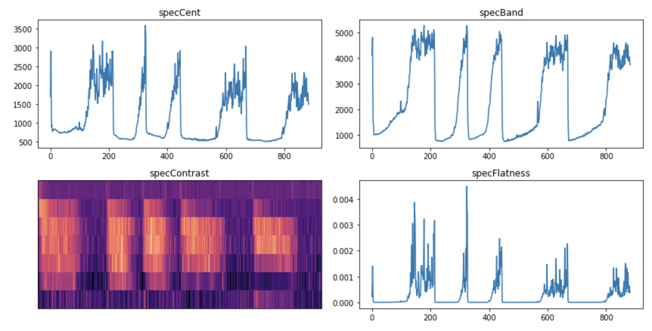
Spectral Analysis
Piano Plagal Cadence Equal
Piano Plagal Cadence Just

Slide 14
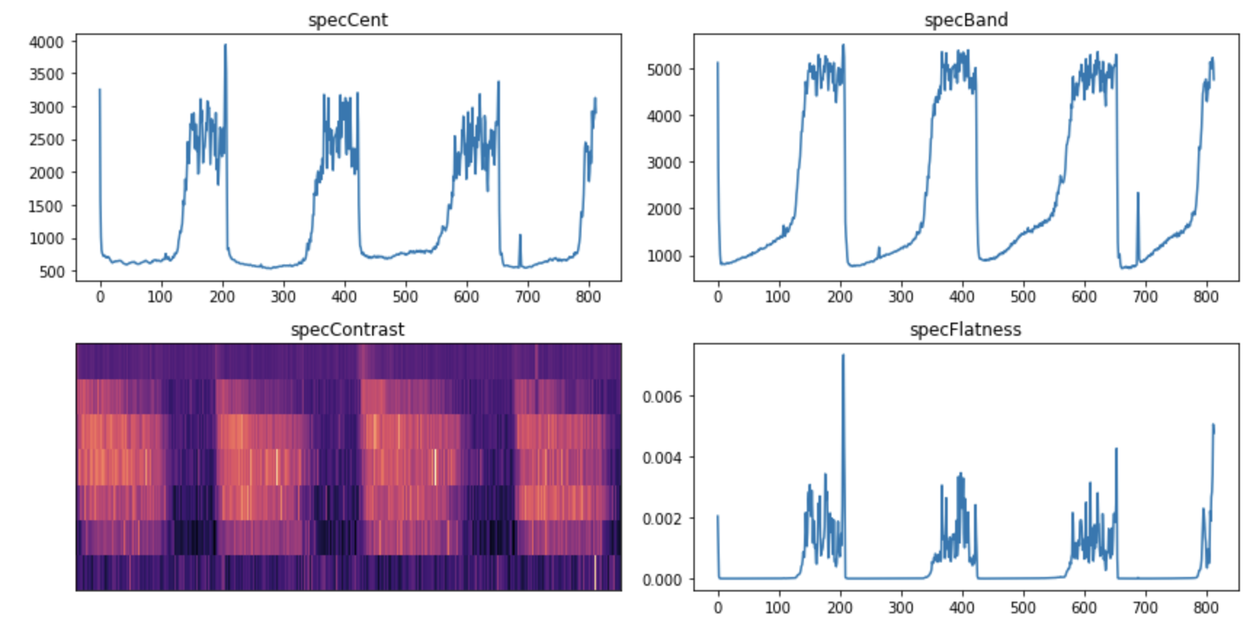

Spectral Analysis
Piano Imperfect Cadence Equal
Piano Imperfect Cadence Just

Slide 15
Conclusion
comparison of several equal and just tempered sequences functions as somewhat coherent tool for analysis
distinguishing differences, such as interval relationships, stability and directions of chords/functions, differences in spectrum
hardest challenge is definition of the issue at hand:
is on actually richer than the other can be discussed (though spectrograms provide strong evidence for higher Spectral Centricity in Just and lower levels of flatness in Equal)
Is the cognitional difference about "timbre", "color", or "richness of sound" in general? And how can those be evaluated or expressed?
listening and perception are individual - one common phenomenon in Western listeners due to conditioning -> just intonation sounds "different", or "off” – Does that maybe deceive the perception/description of the sound being "richer"?

